Slide 1
Meeting with Rothbart Lab

Slide 2
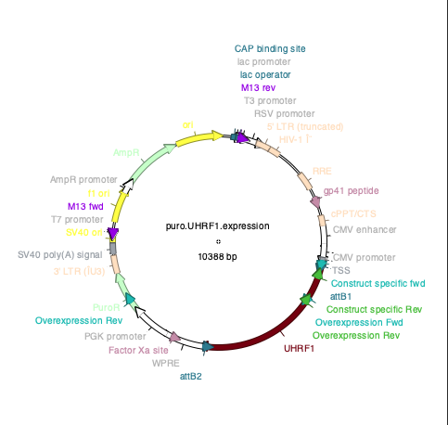
UHRF1 OVX vector

Slide 3
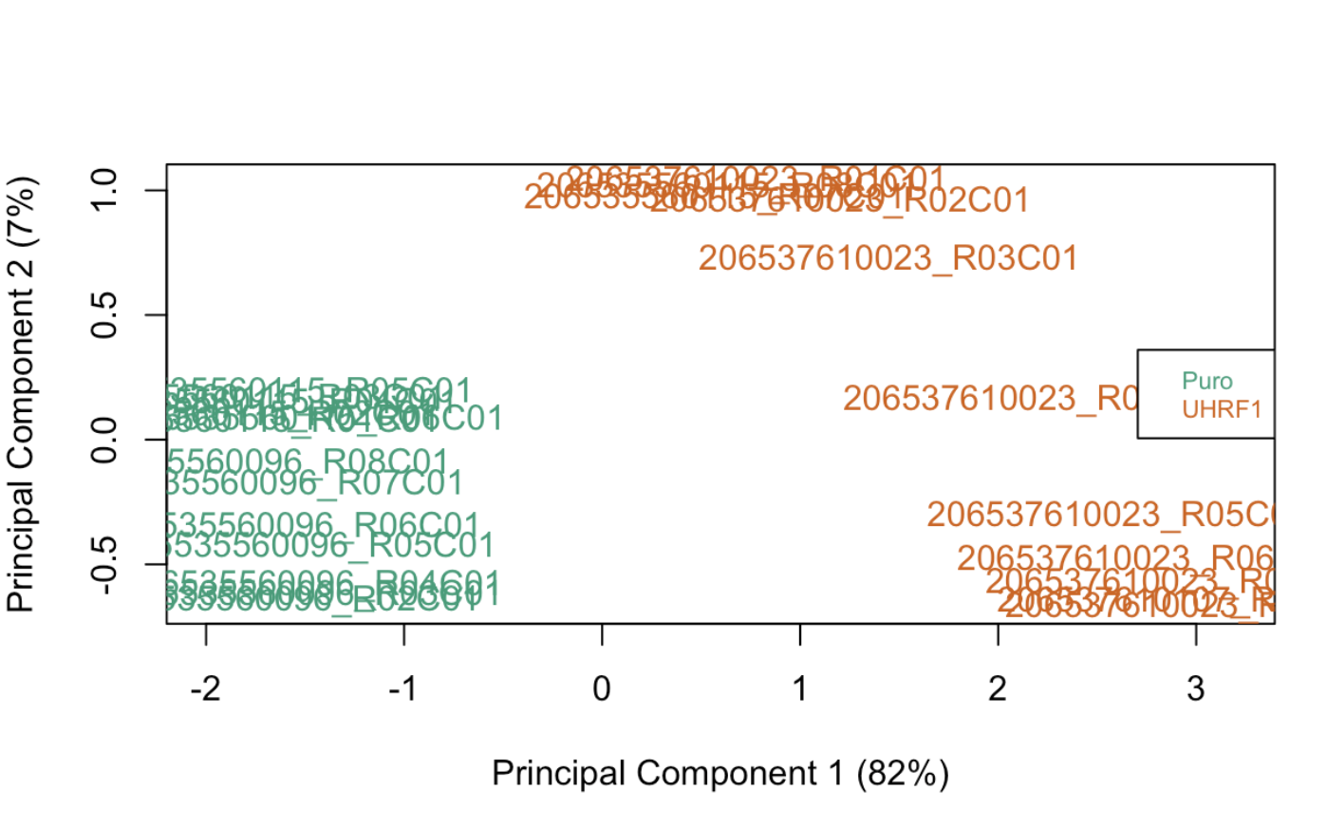
PCA plot of UHRF1_overexpression
Using 1000 common gene annotation to calculate PCA

Slide 4
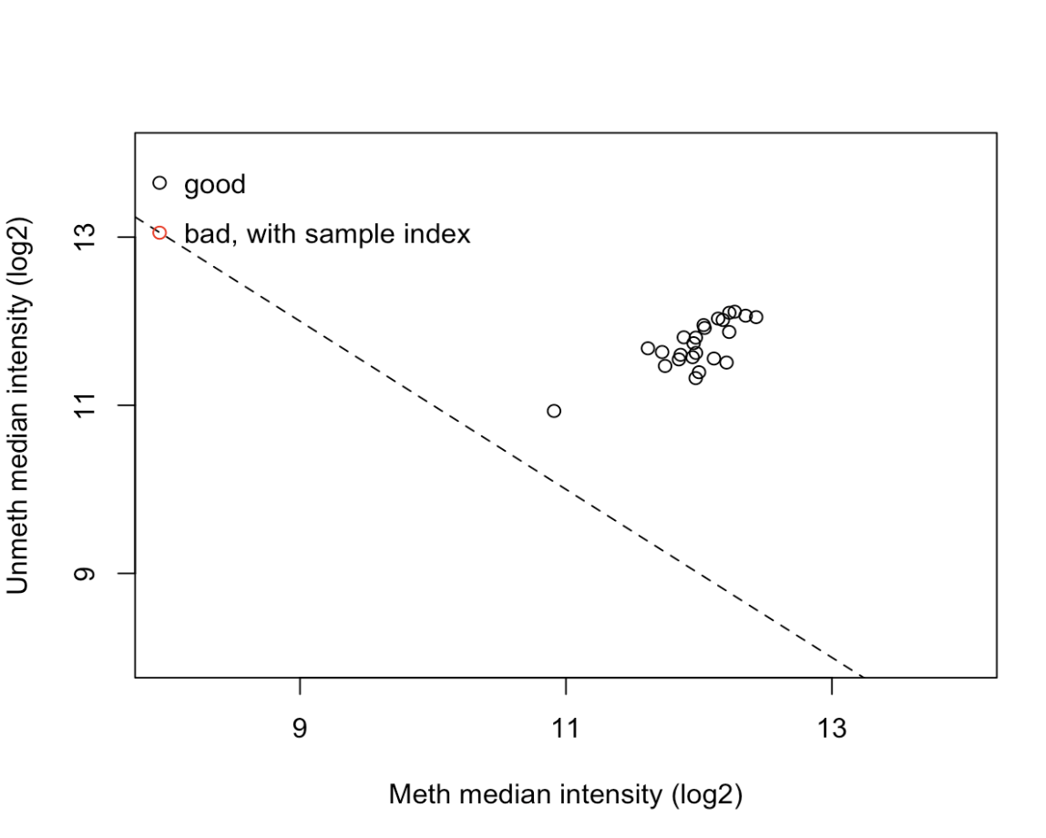
QC plot
RgSet -> ratio clustering
Most samples are clustered together.

Slide 5
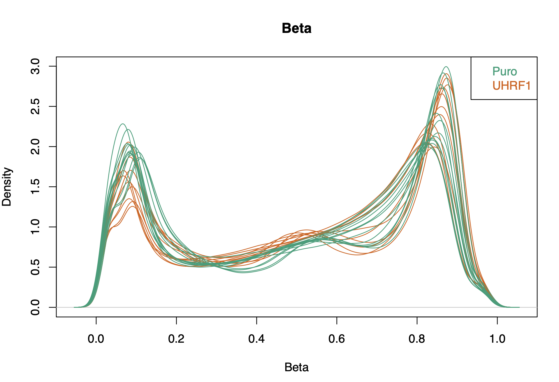
Density Plot of UHRF1_overexpression

Slide 6
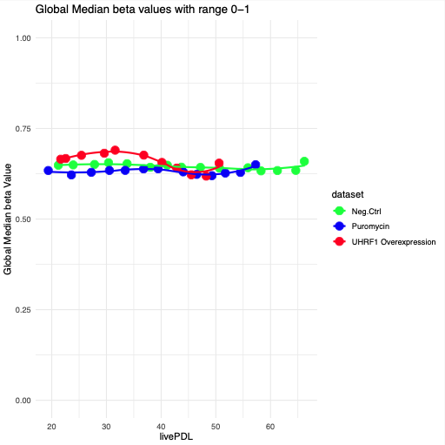
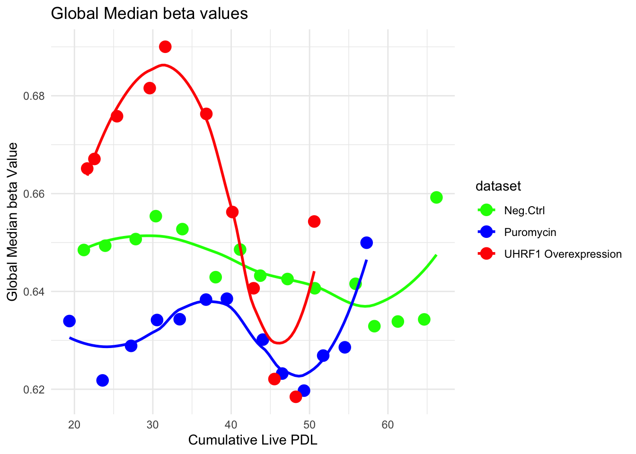
UHRF1_OVX has global hypermethylation than the puromycin control

Slide 7
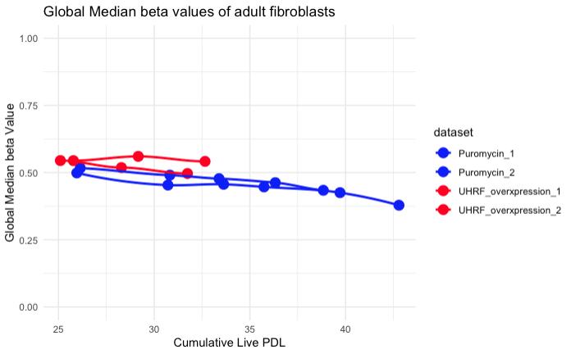
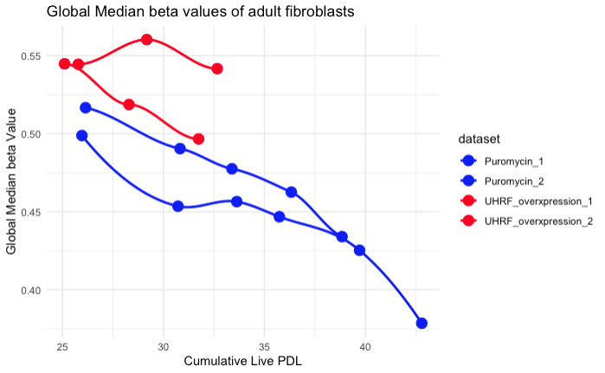
Adult fibroblasts also show global hypermethylation
zoomed in.

Slide 8
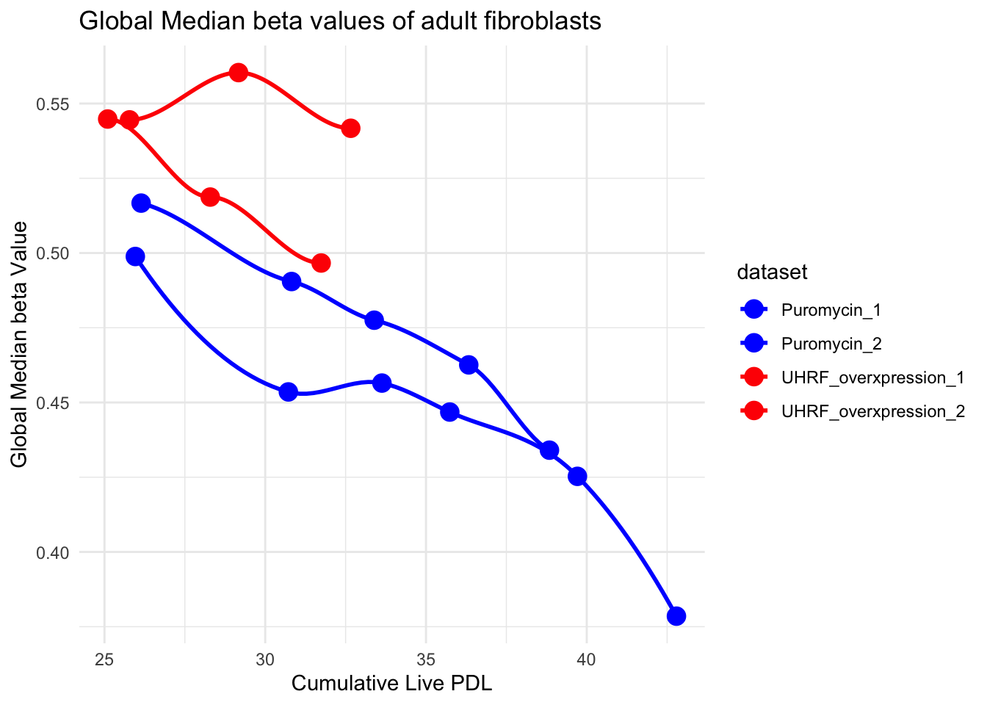

Slide 9
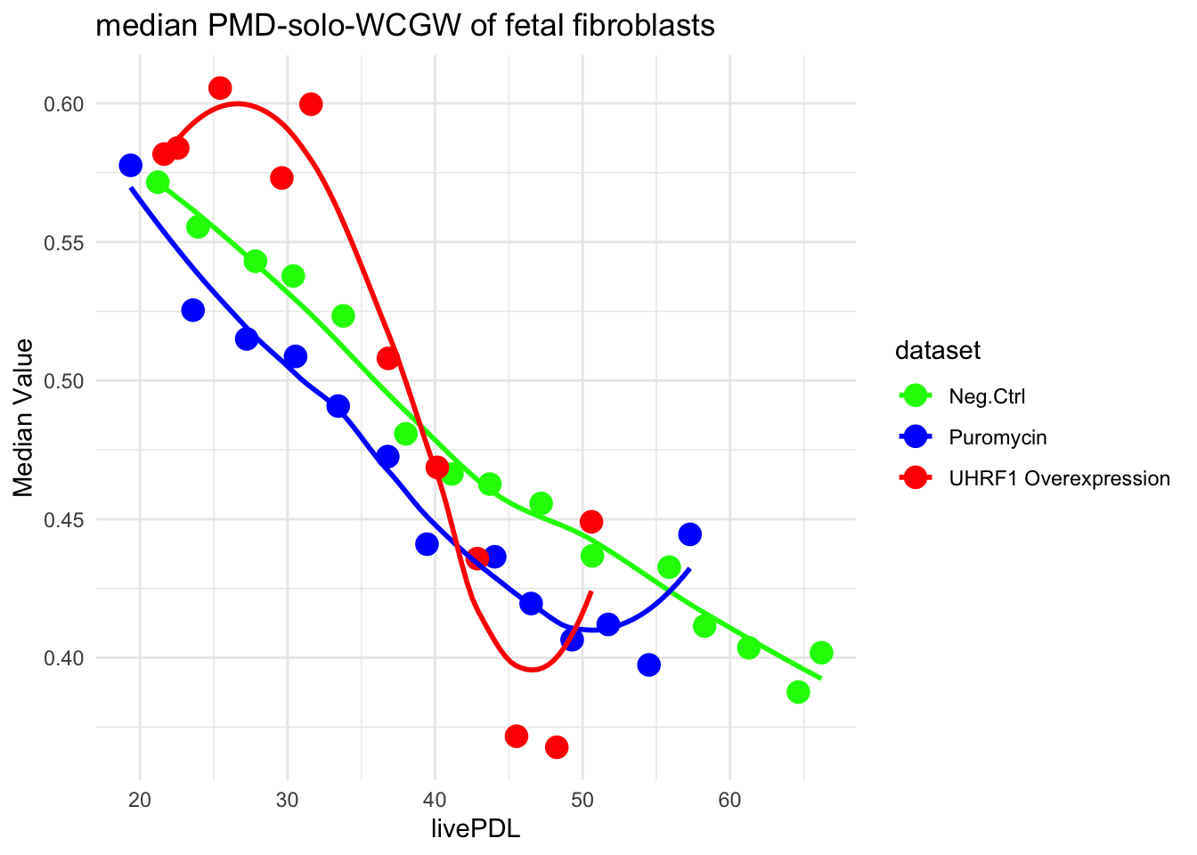

Slide 10
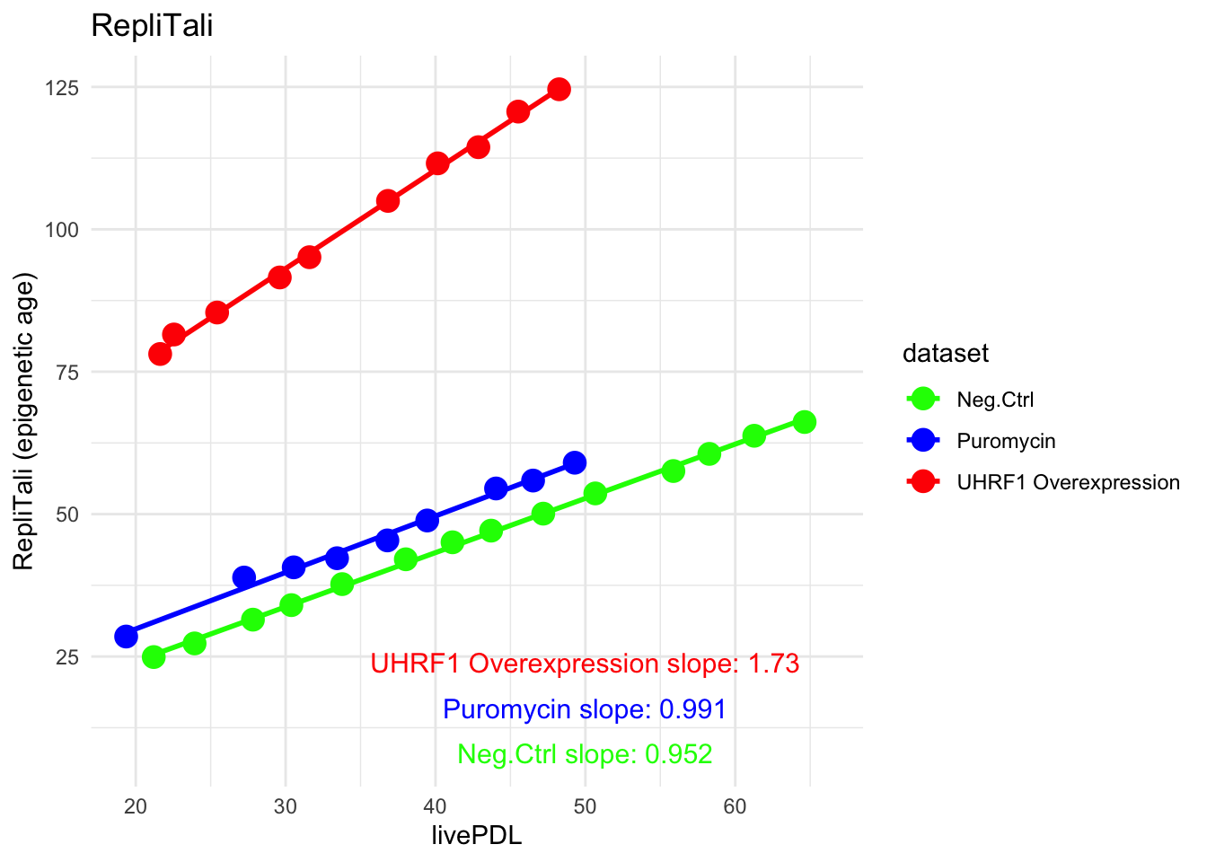
UHRF_OVX shows higher Replitali (epigenetic age) slope

Slide 11
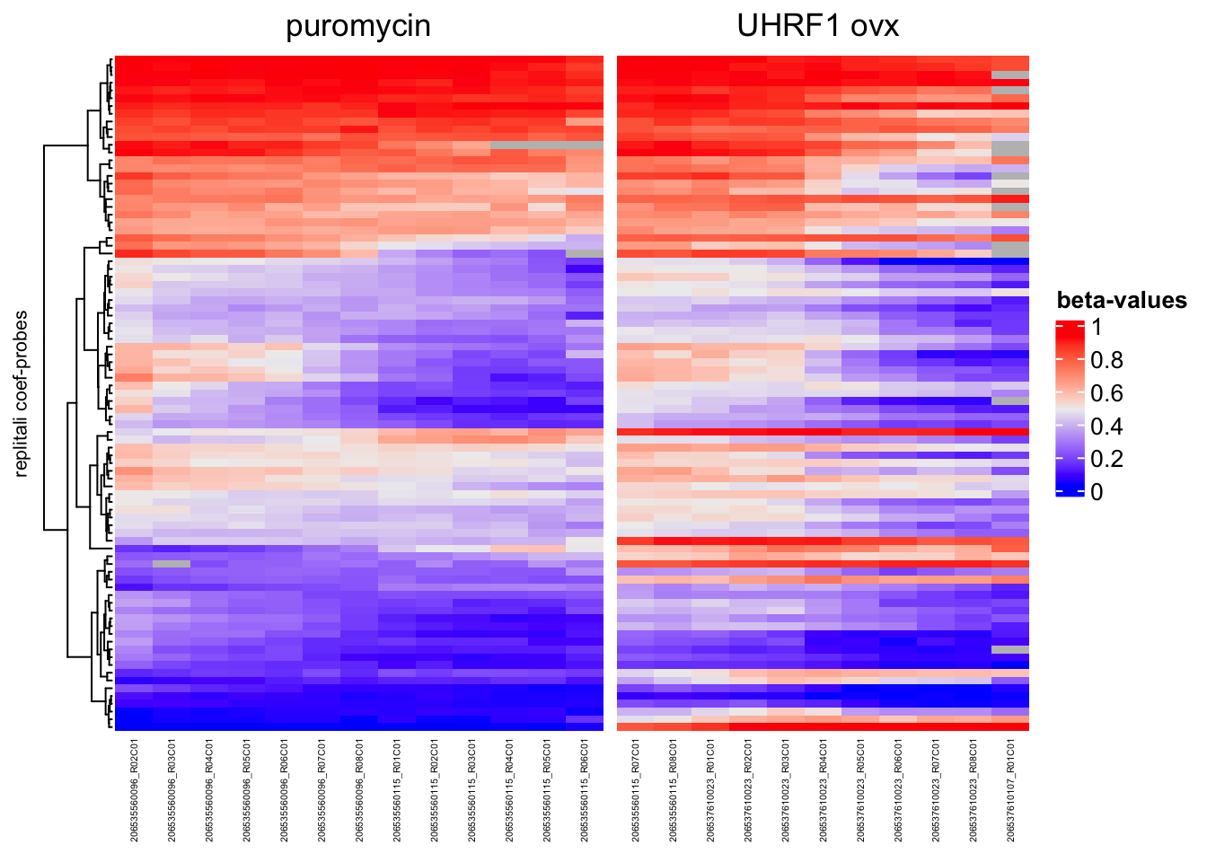
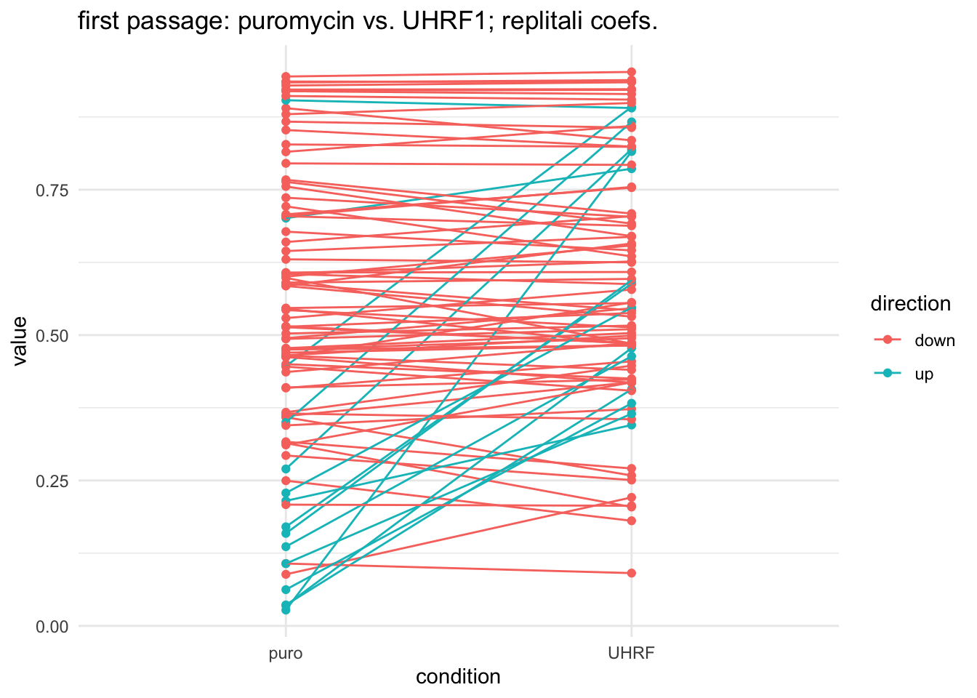
Why is the Y-intercept for UHRF1 so high?

